Slide 1
KUBERNETES WEEK-1
TOPICS COVERED IN WEEK-1
KUBERNETES ARCHITECTURE
KUBERNETES COMPONENTS
CUSTOM RESOURCE DEFINITION
KUBERNETES OPERATORS
ISTIO
JAEGER AND KIALI

Slide 2
Why Kubernetes?
Docker is an image building, storing and container creation technology but kubernetes is container orchestration technology.
At one point of time it is very difficult to manage docker containers spanning over multiple hosts.
So we need Kubernetes for the below
• Auto Scaling Networking
• High Availability
• Reliability Self Healing
• Storage mechanism

Slide 3
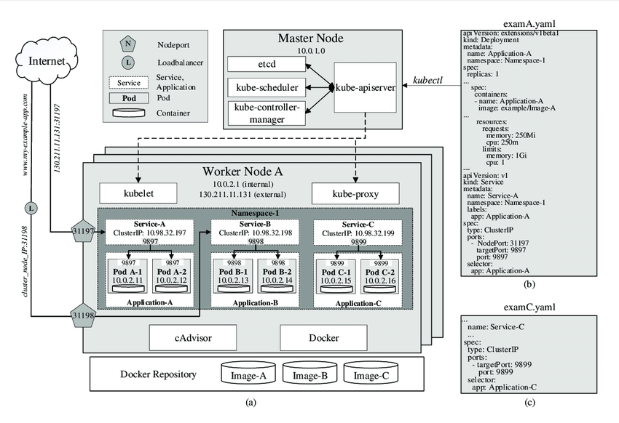
KUBERNETES ARCHITECTURE

Slide 4
Service in Kubernetes
Pods are naturally ephemeral in Kubernetes.So Pod IP will be changed every time it is created. To achieve pod to pod communication we can't re on IP addresses. Solution is service.
Service can have name and Port when a pod is created it can go attached to service itself. It acts as a service mesh. Multiple pods can be attached to service based on label selectors. Service acts as Load balancer between pods.

Slide 5
Types of Service
Cluster IP: Default type. It can get one IP address. We can configure cluster IP service to achieve pod to pod communication, But it can't be accessed over the internet.
Node Port: Node Port by default creates cluster IP in background. When we say NodeRort a port will be opened on each and every node. This port will be redirected to the cluster IPNode Port can be accessed over the internet.
Load Balancer: We can create Load Balancer through cloud providers like AWS, GCP, Azure, etc. Load Balancer by default creates NodePort and Cluster IP in the background. Load Balancer -> NodePort -> Cluster IP

Slide 6
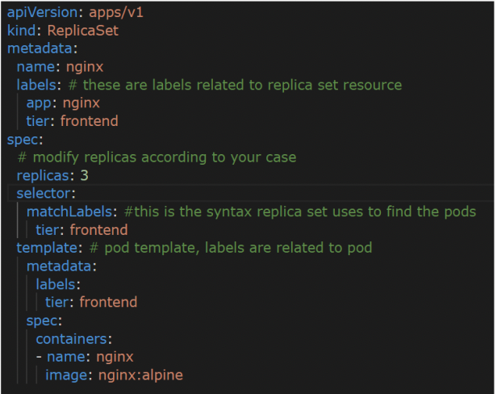
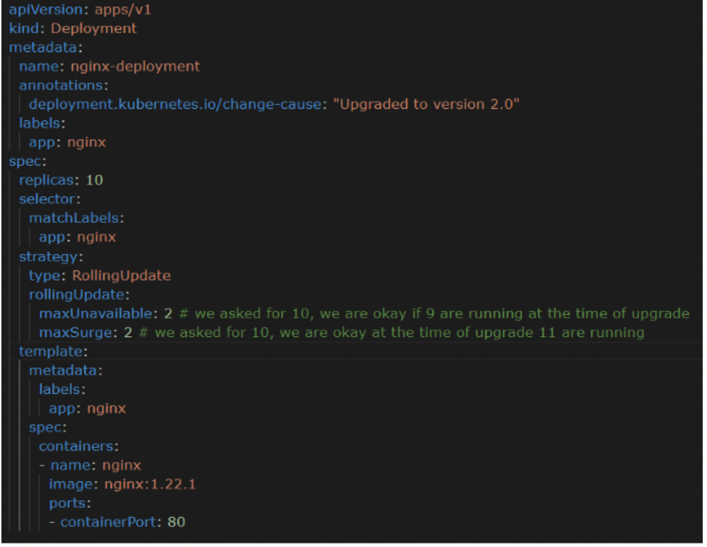
Replica Set
Deployment
Deployment creates Replica Set in background to maintain the desired number of replicas We can use deployment for stateless applications. Finally Deployment is the highest resource in Kubernetes to maintain Availability - Make sure desired no of replicas are always available Scalability - Can be used to scale at runtime based on traffic. Maintainability - We can do the updates with new image versions.
It guarantees the declared no of pods will run always. It is the most important feature of high availability and autoscale.

Slide 7
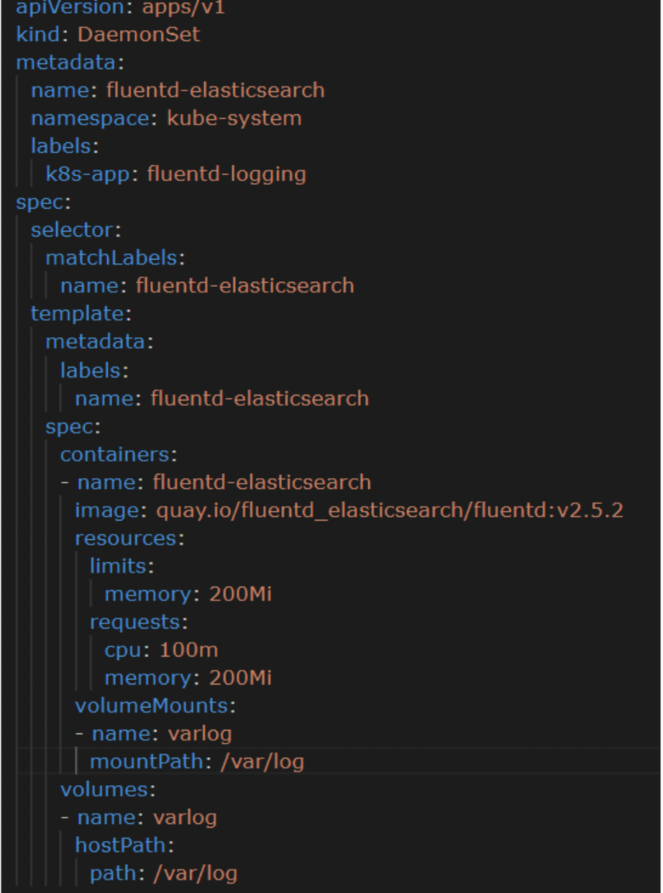
Daemon Set
The Daemon set is similar to Deployment. But there is only one difference. Deployment makes pods available in any node.

